Slide 1
Sequential Deep Learning for Personalized HbA1c Response Prediction and Treatment Ranking in Type 2 Diabetes

Slide 2
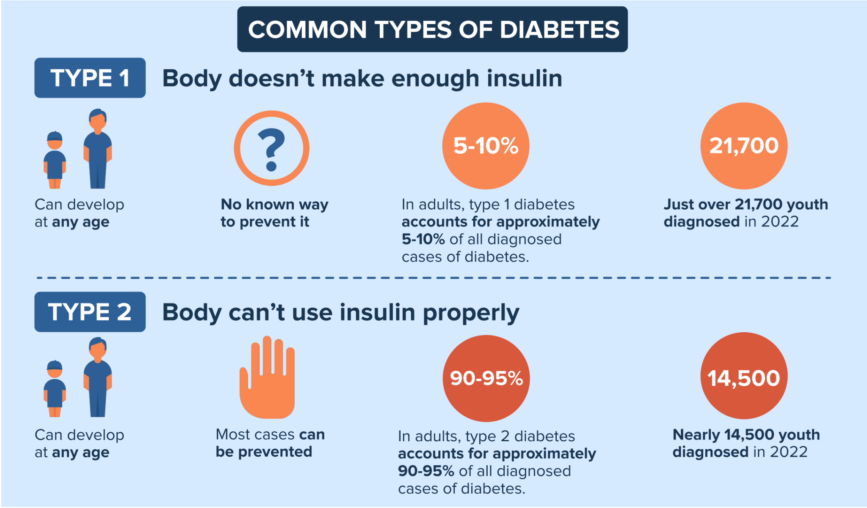
Intro
Type 2 diabetes is a major global health problem
Accounts for ~90–95% of all diabetes cases
Poor glucose control → serious complications
Multiple treatment options available
Overview of Type 1 and Type 2 Diabetes in the U.S. (CDC)
https://www.cdc.gov/

Slide 3

Clinical Problem
Multiple glucose-lowering medications
Patients respond differently to each treatment
Current decisions based on guidelines and averages
No clear way to choose the best drug for an individual

Slide 4
Why Prediction Matters
Current Approach
Goal
Population-level guidelines
Does not account for individual variation
Predict patient-specific treatment response
Enable personalized therapy selection

Slide 5
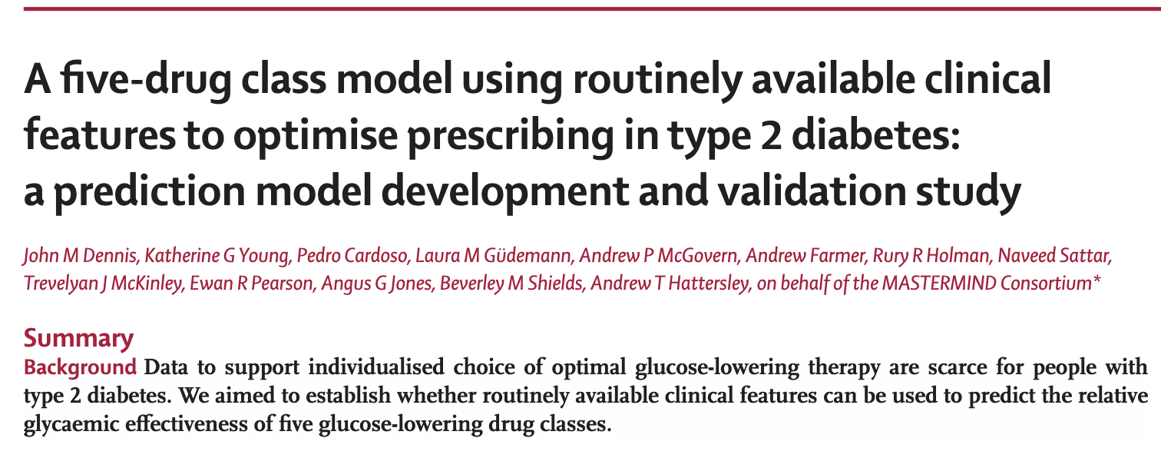
Prior Work (Lancet paper)
Developed model to predict 12-month HbA1c
Compared five drug classes per patient
Selected optimal therapy (lowest predicted HbA1c)
Showed improved outcomes with model-guided treatment
Based on static baseline features
https://doi.org/10.1016/ S0140-6736(24)02617-5

Slide 6
Research Question
Does incorporating patient history improve prediction of treatment response?

Slide 7
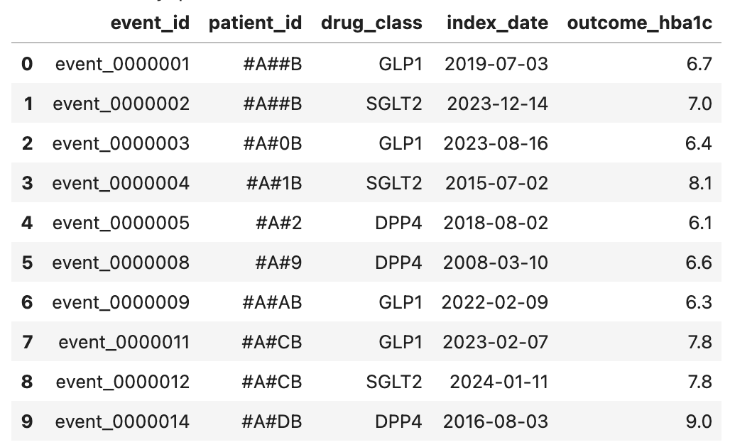
Data
TriNetX EHR dataset
~120,000 treatment initiation events
Each data point = patient starting a medication
Features: demographics, labs, medications, and history
Input: patient data before treatment
Output: HbA1c ~12 months after treatment
Two settings:
Broad (real-world, more noise)
Unchanged therapy (cleaner, more controlled)

Slide 8
Modeling
01
Elastic Net
HistGradientBoostingRegressor (HGBR)
Static (Non-deep learning)
02
Convolutional Neural Network (CNN)
Static (Deep learning)
03
Gated Recurrent Unit (GRU)
Longitudinal (Deep learning)

Slide 9
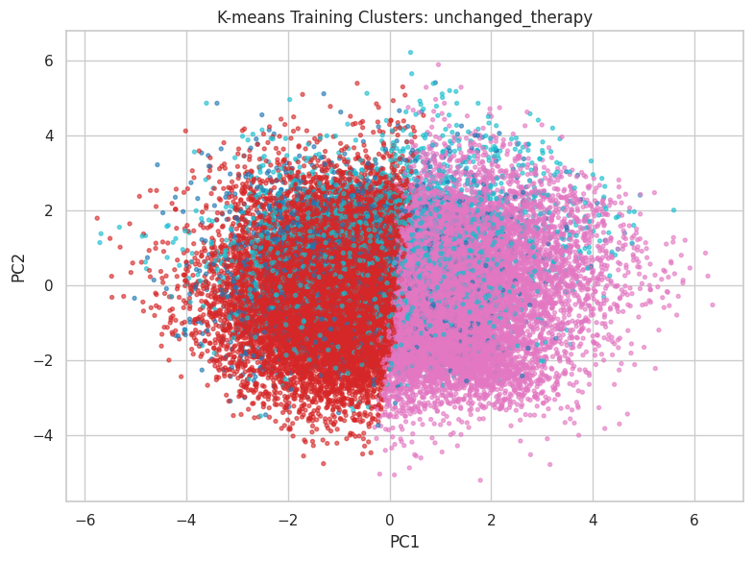
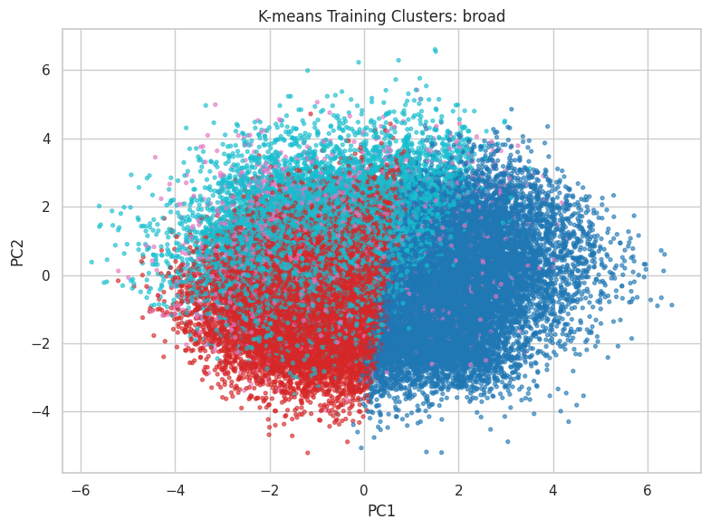
Exploratory Analysis (K-means Clustering)
Low silhouette score (~0.07–0.08)
Weak cluster separation
Some variation in HbA1c across clusters
No clear patient subgroups identified

Slide 10
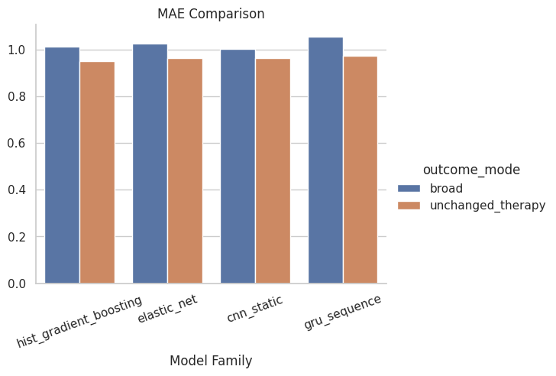
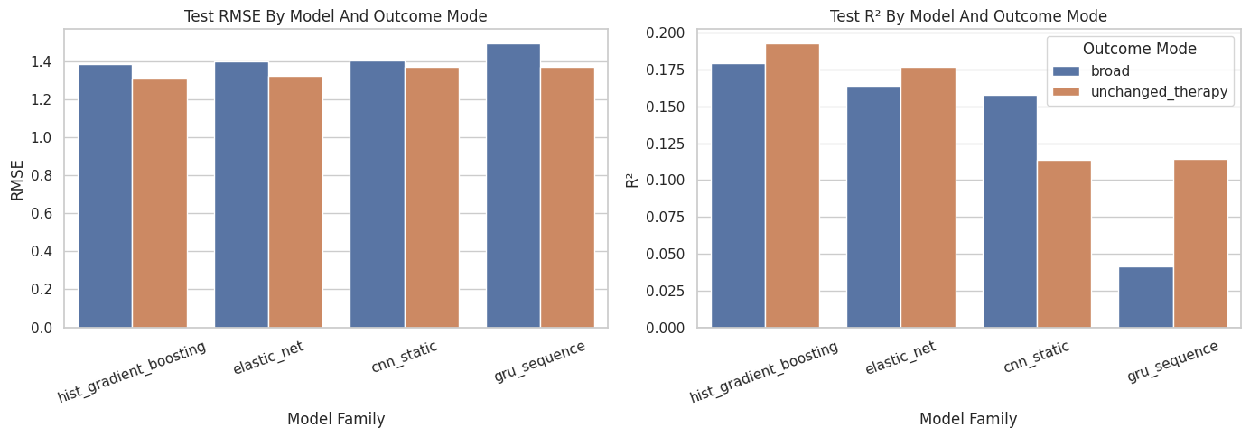
Results
Static models outperform longitudinal deep learning across both settings

Slide 11
Results - Interpretation
Static models performed best
Longitudinal model did not improve
Outcome definition matters
Predictive signal is limited
HGBR achieved lowest error (RMSE ~1.31) and highest R² (~0.19)
GRU showed higher error (RMSE up to ~1.49) and much lower R² (~0.04)
Performance improved in the unchanged-therapy, suggesting reduced noise leads to better predictions
Even best model explains <20% of variance

Slide 12
Discussion
Real-world EHR data is noisy and incomplete
Outcome affected by unobserved factors (adherence, lifestyle)
Limited temporal consistency in patient records
Deep learning models may require larger or richer data
#
Data limitations, not model choice, are the primary constraint in this setting.

Slide 13
Conclusion
Successfully modeled treatment response in T2D using EHR data
Static models outperformed longitudinal deep learning
Longitudinal data did not improve prediction in this setting
Model performance limited by real-world EHR data quality
Future work: richer data and improved temporal modeling

